Slide 1

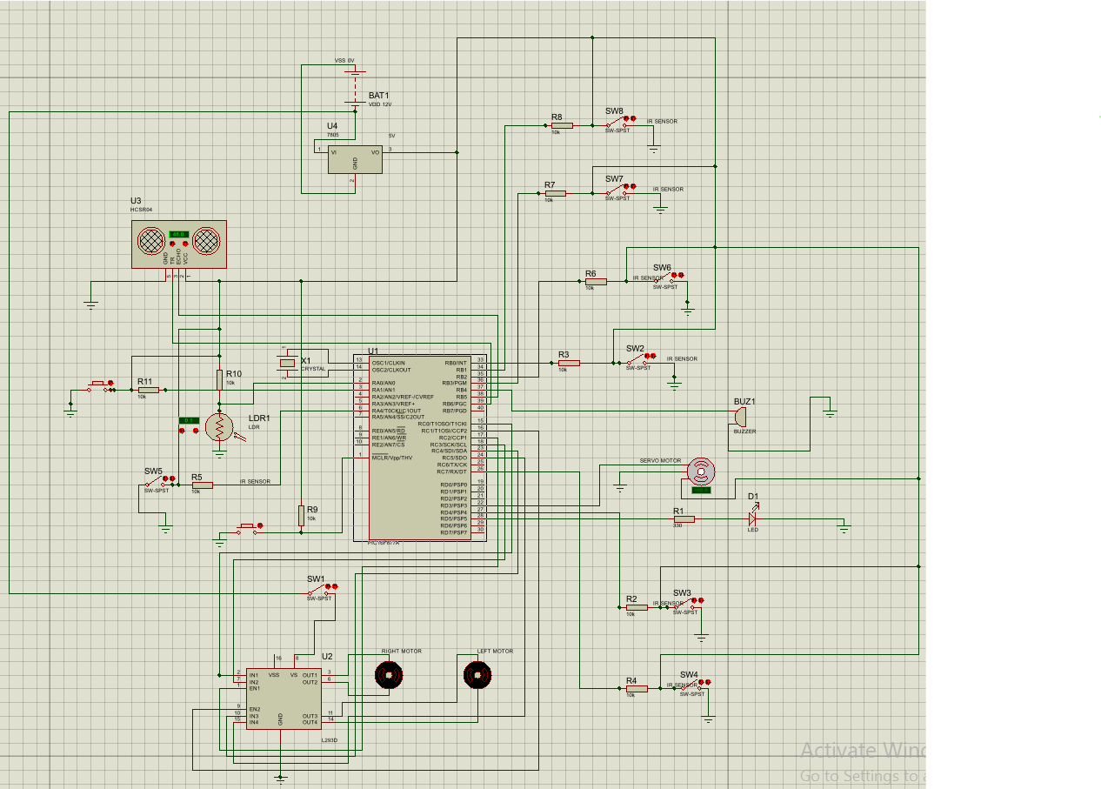
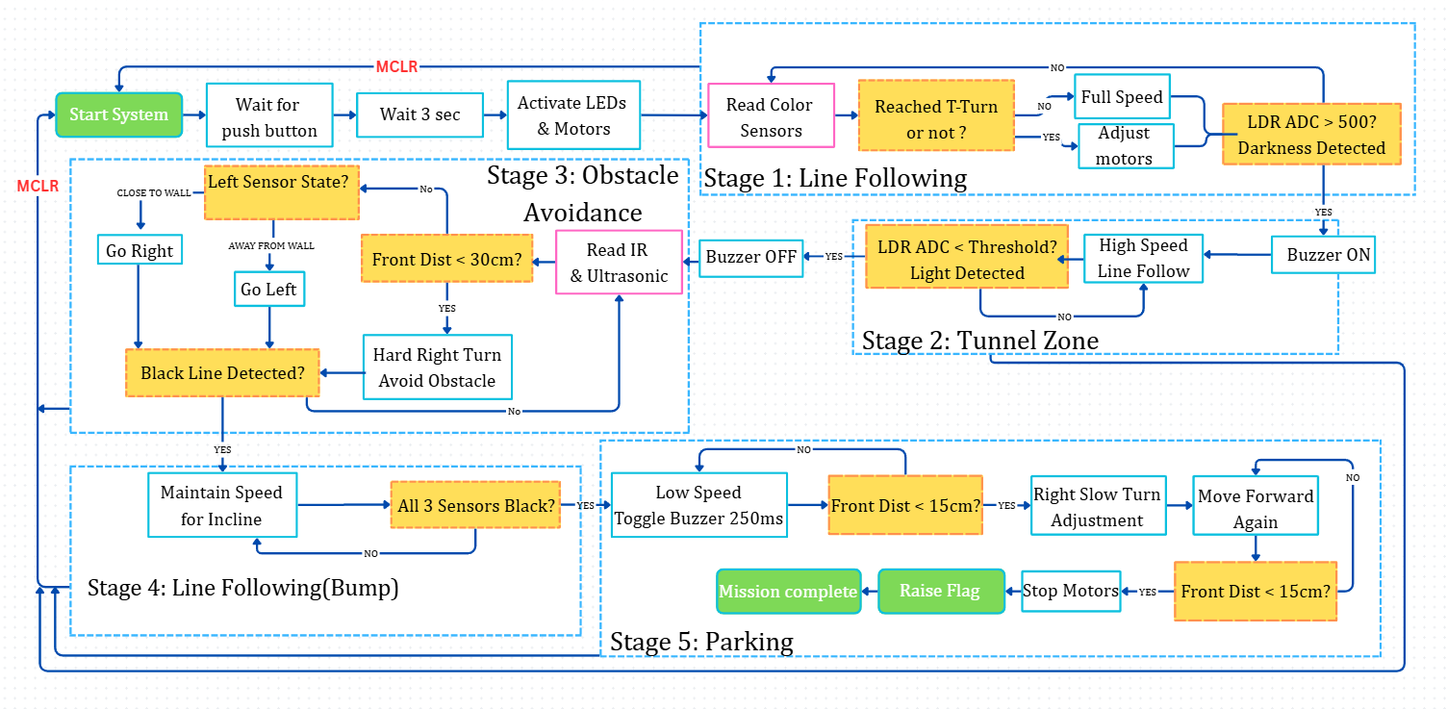
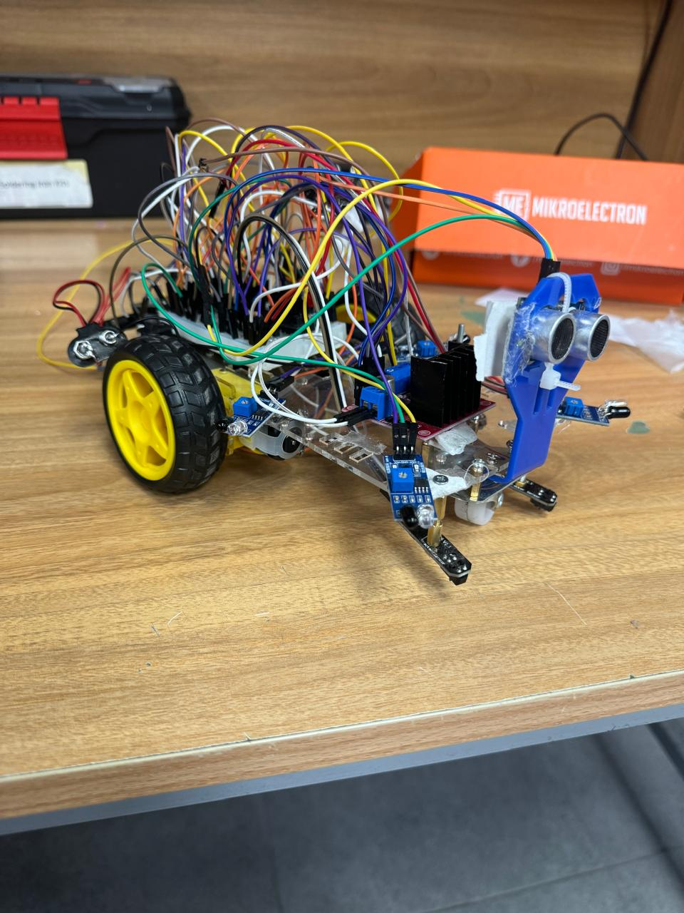
Embedded Systems
Autonomous Mobile Robot Design
Harith Alfazza, Baraa Ishtaiwe, Baraa abdelhadi
Supervisor: Prof.Belal sababha
Embedded Systems Final Design Project, Fall 2026
King Abdullah II School of Engineering
Princess Sumaya University for Technology
Introduction
This project presents the design and implementation of an autonomous mobile robot engineered to navigate a multi-stage competitive track without human intervention. The system is built around the PIC16F877A microcontroller and features a differential drive chassis equipped with ultrasonic, infrared, and color sensors. The robot's mission involves transitioning seamlessly between high-speed line following, traversing a dark tunnel using light intensity detection, and performing obstacle avoidance and precision parking. A defining constraint of this design was the strict prohibition of standard compiler libraries; consequently, all control logic including motor Pulse Width Modulation (PWM), sensor Analog-to-Digital Conversion (ADC), and timing operations was implemented through direct low level register manipulation, demonstrating a rigorous understanding of embedded systems architecture.
Figure 2: Electrical Design.
The system uses a PIC16F877A microcontroller with an L293D H-Bridge to drive DC motors via PWM, while sensors provide light and environmental inputs. Separate 5V logic and 12V motor supplies are used to reduce noise and ensure stable operation.
Figure 3 Mechanical Design.
The robot employs a differential drive for zero-radius turning, with front-mounted ultrasonic and IR sensors for early obstacle detection and centrally placed color sensors to ensure stable line tracking on curves.
Results
Experimental results verified reliable autonomous operation across multiple scenarios, including line following, tunnel traversal, and obstacle avoidance. Using a non-blocking Timer0 ISR to control the buzzer eliminated delay-induced motor instability, while an improved proximity-based parking correction ensured accurate, parallel alignment with the wall.
.
System Design
Figure 3: Software Design
The control logic relies on a Finite State Machine rather than linear execution. Crucially, we avoided blocking delays by implementing a Timer0 Interrupt Service Routine (ISR) that overflows every 1ms. This allows the robot to handle background tasks—such as beeping the buzzer in the tunnel—simultaneously with high-speed motor control, preventing the "stuttering" issues common with standard delay functions.
Conclusion
The project demonstrates that advanced autonomous behaviors can be achieved on a low-cost microcontroller through low-level, register-based programming. By avoiding standard libraries, precise timing and efficient resource management were achieved, enabling reliable multitasking via custom interrupts where blocking methods fail. The results highlight the importance of hardware-level control in real-time, resource-constrained embedded systems, with future improvements suggested through adopting PID steering for smoother high-speed performance.
GitHub Link: https://github.com/baraaabuzayed/Embedded-Systems-Project.git

